Slide 1

WAY TO ENTERPRISE
React JS
VTI ACADEMY
Author: duy.nguyenngoc1@vti.com.vn
March 2020

Slide 2
Agenda
Destructuring
Template String
...Operator
Arrow Function
Asynchronous Programming
Assignments
Copyright © VTI Academy All Rights Reserved

Slide 3
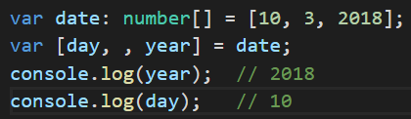
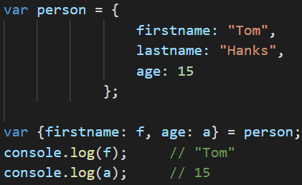
Destructuring
Array
Object

Slide 4
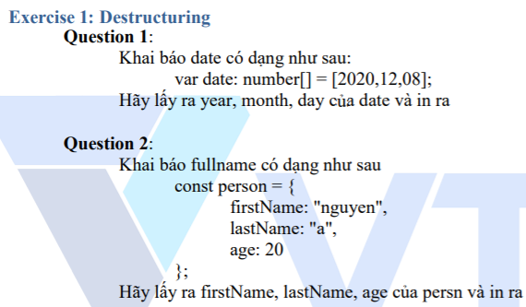
Testing System Assignments
Exercise 1: Destructuring

Slide 5
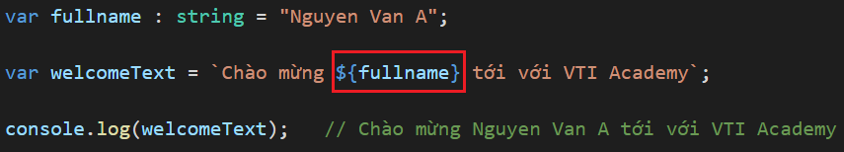
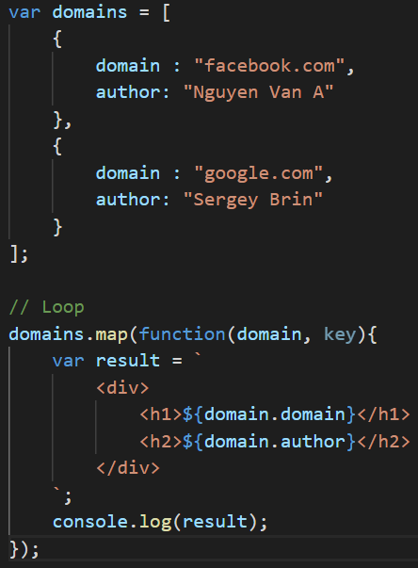
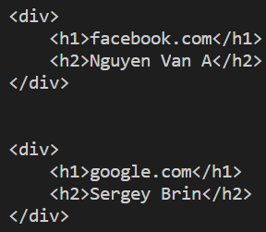
Template String
String
Loop

Slide 6
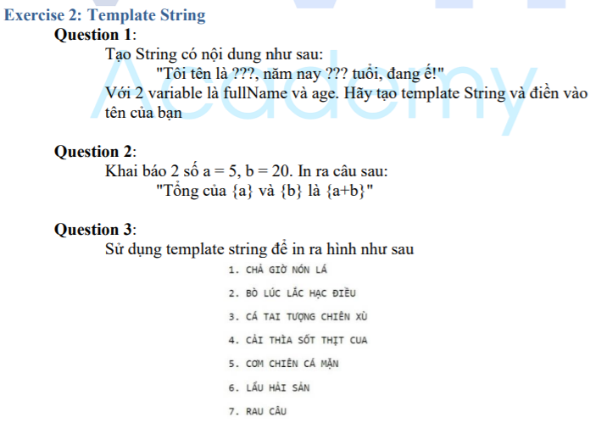
Testing System Assignments
Exercise 2: Template String

Slide 7
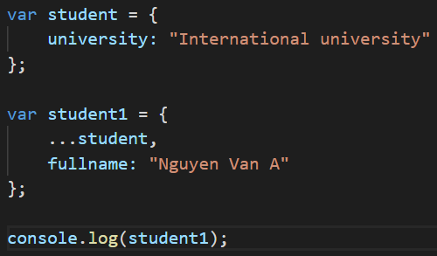
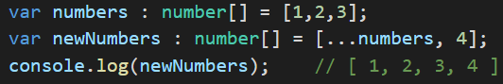
... Operator
Spread element in array or object

Slide 8
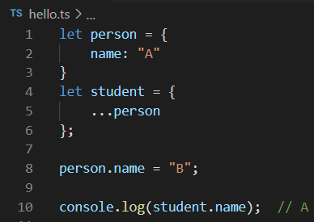
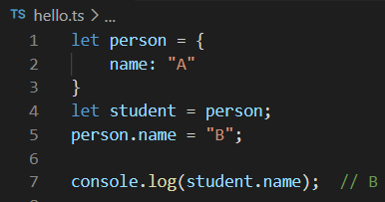
... Operator
pointer (reference)
Reference
Copy

Slide 9
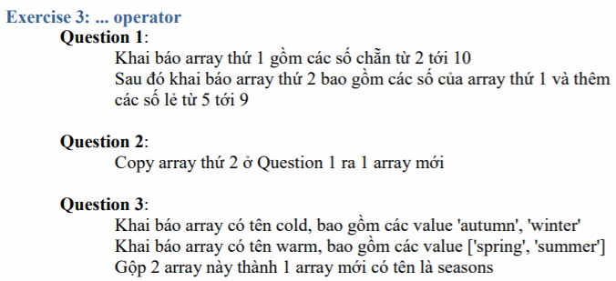
Testing System Assignments
Exercise 3: ... operator

Slide 10
Function
Function
Function Constructor
Normal Function
Arrow Function

Slide 11
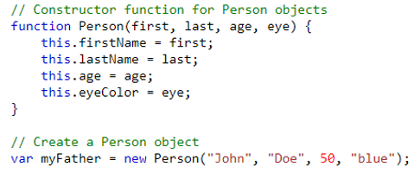
Function Constructor
Same Javascript

Slide 12
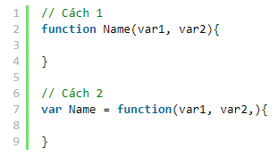
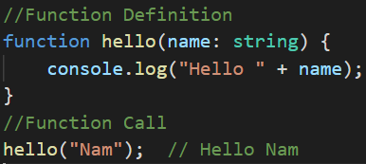
Normal Function
Syntax
Example:
Same Javascript

Slide 13
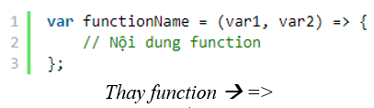
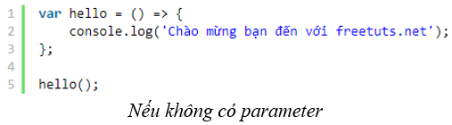
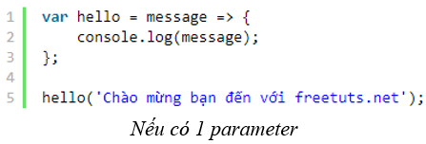
Arrow Function
Syntax

Slide 14
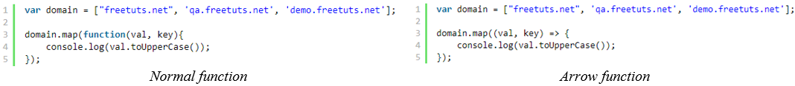
Arrow Function
callback
https://developer.mozilla.org/en-US/docs/Web/JavaScript/Reference/Global_Objects/Array/map

Slide 15
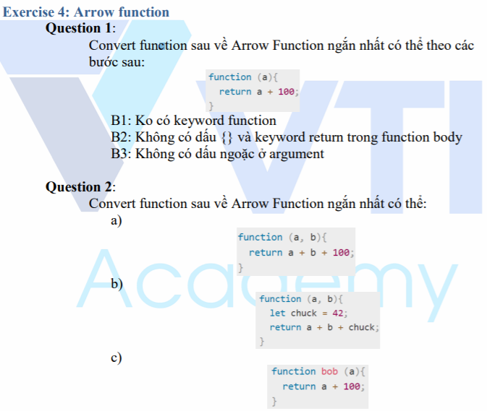
Testing System Assignments
Exercise 4: Arrow function

Slide 16
Parameter
Default parameter
Rest parameter
Optional parameter
Anonymous Object as parameter

Slide 17
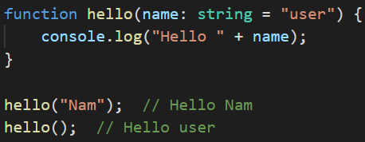
Default Parameter

Slide 18
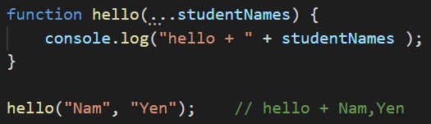
Rest Parameter

Slide 19
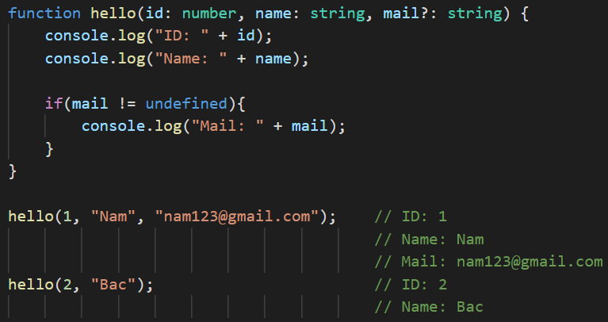
Optional Parameter

Slide 20
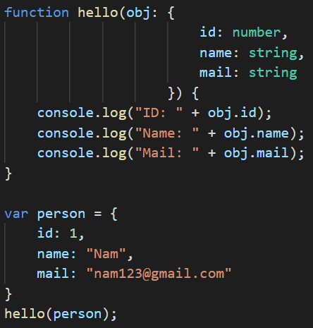
Anonymous Object as parameter

Slide 21
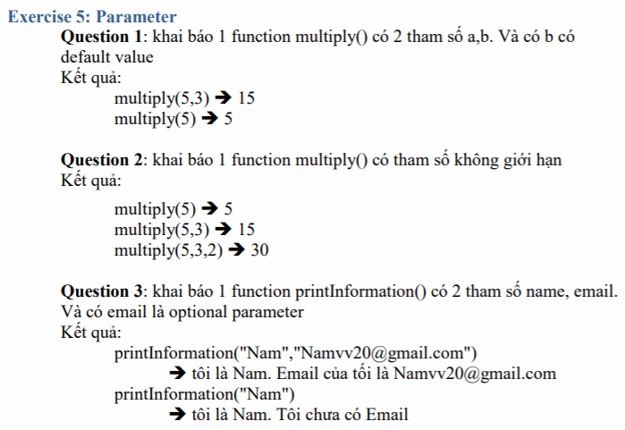
Testing System Assignments
Exercise 5: Parameter

Slide 22
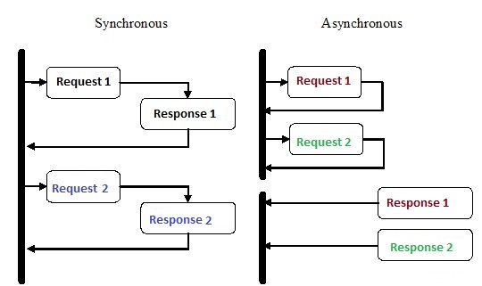
Asynchronous Programming
Callback
Promise
Async/Await

Slide 23
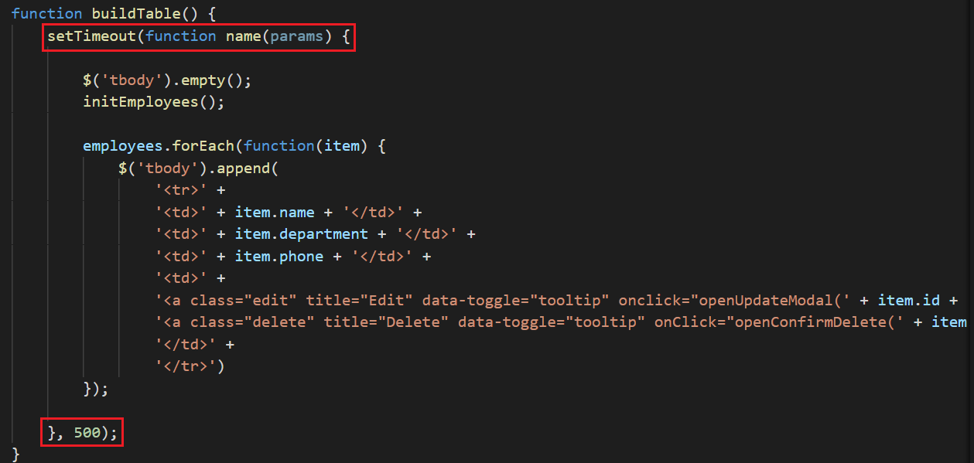
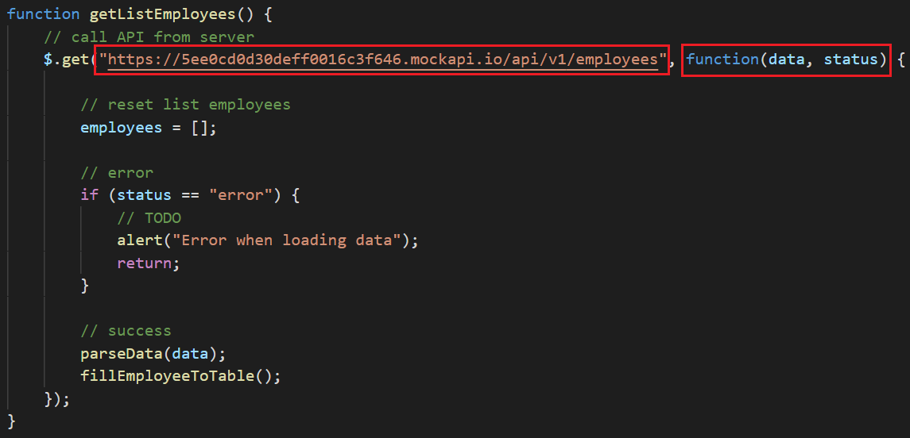
Callback
timeout function
Call api function

Slide 24
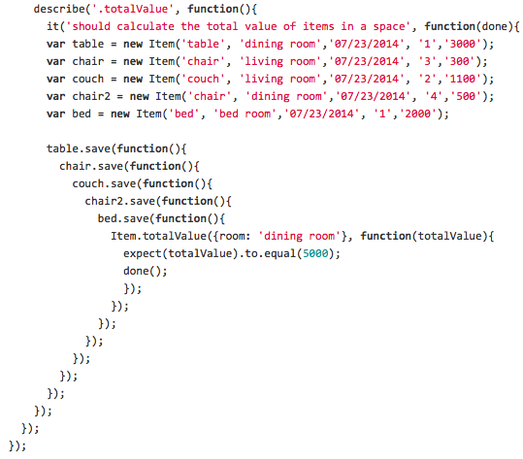
Callback hell
🡺 Using Promise or Async/Await to avoid callback hell

Slide 25
Promise
ES6
init
status
then()
catch()

Slide 26
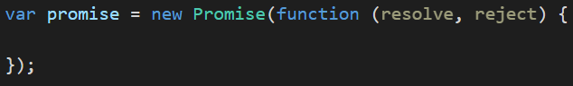
Init
resolve is a callback function that handles a successful action.
reject is a callback function that handles the failure action

Slide 27
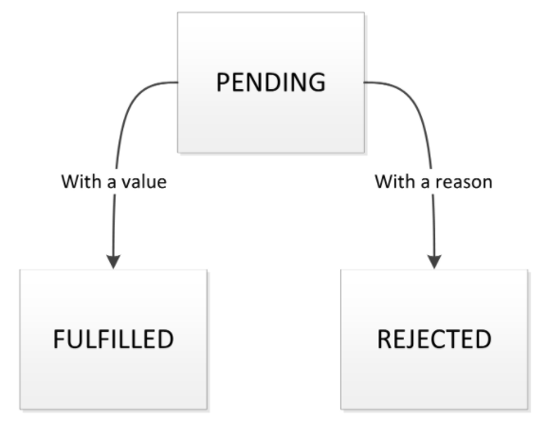
Status
Pending (New)
Fulfilled (Success)
Rejected (Error)

Slide 28
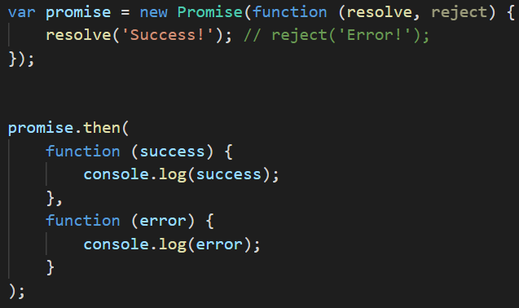
Then
then() is a method that receives the results of promises (success or error)
tsc promise.ts --target es6

Slide 29
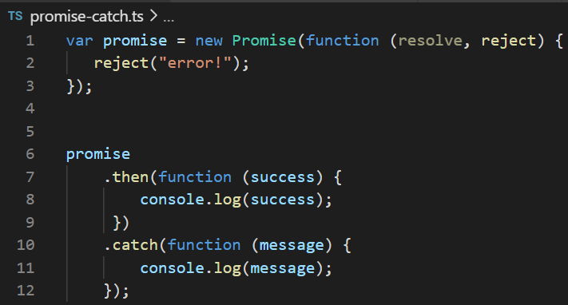
Catch
catch() is a method that only handles the error results of promises
tsc promise.ts --target es6

Slide 30
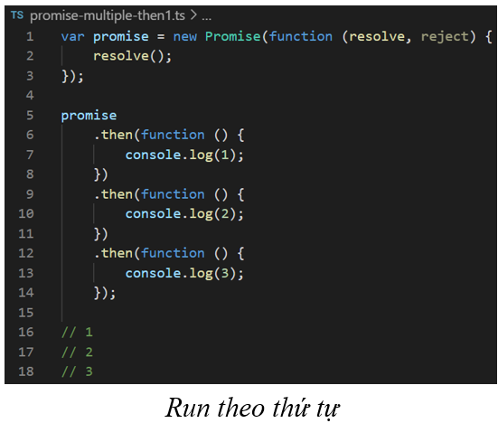
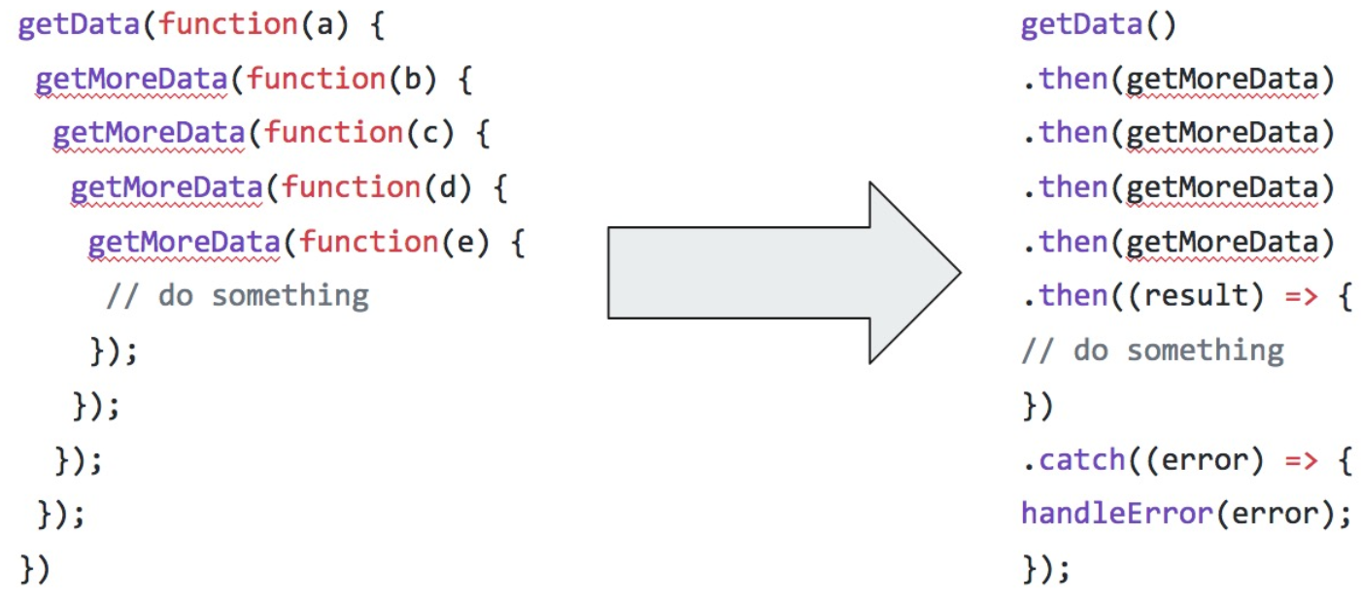
Chain Promise

Slide 31
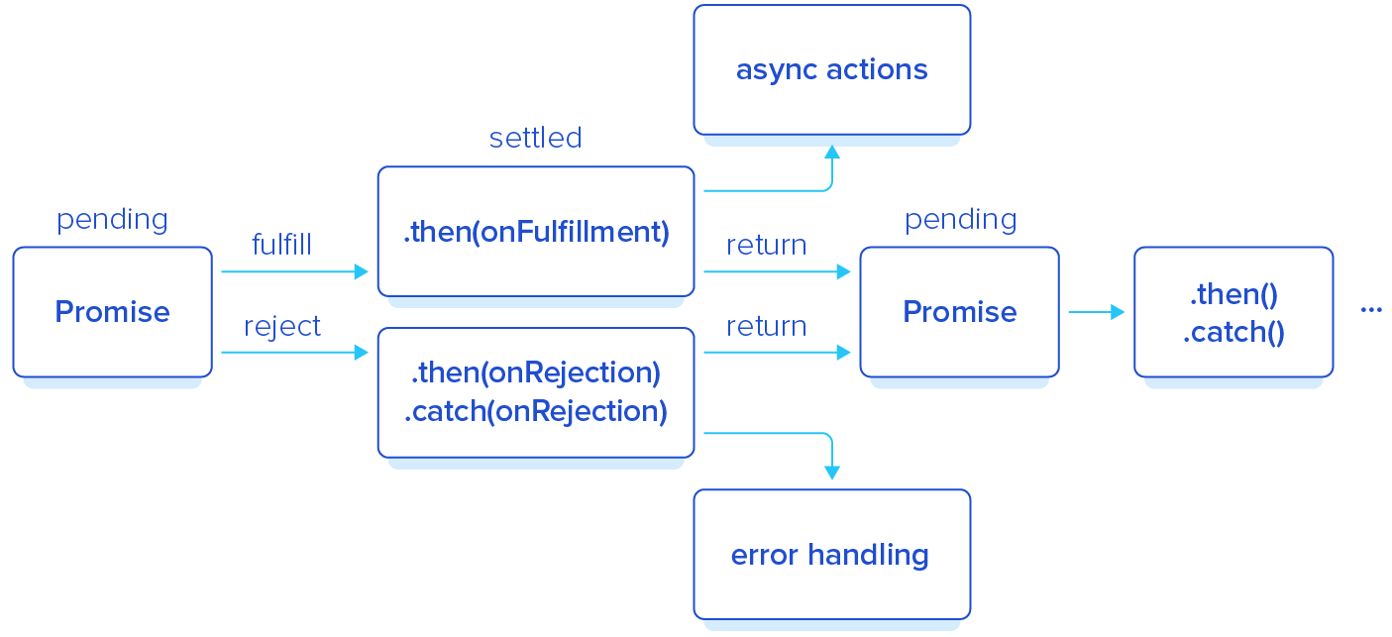
Chain Promise

Slide 32
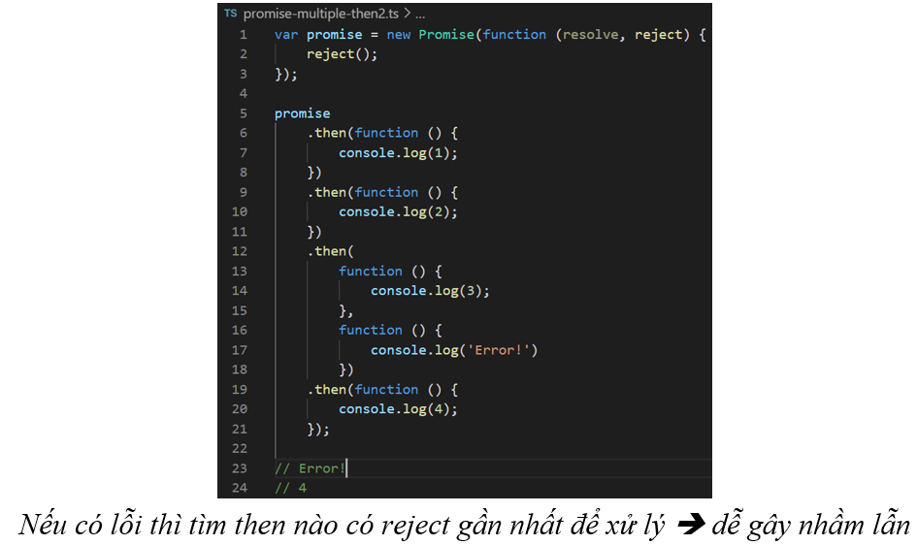
Chain Promise

Slide 33
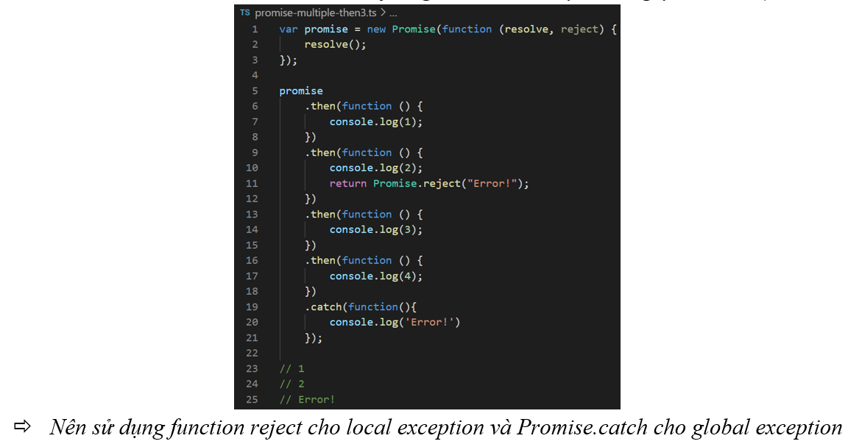
Chain Promise

Slide 34
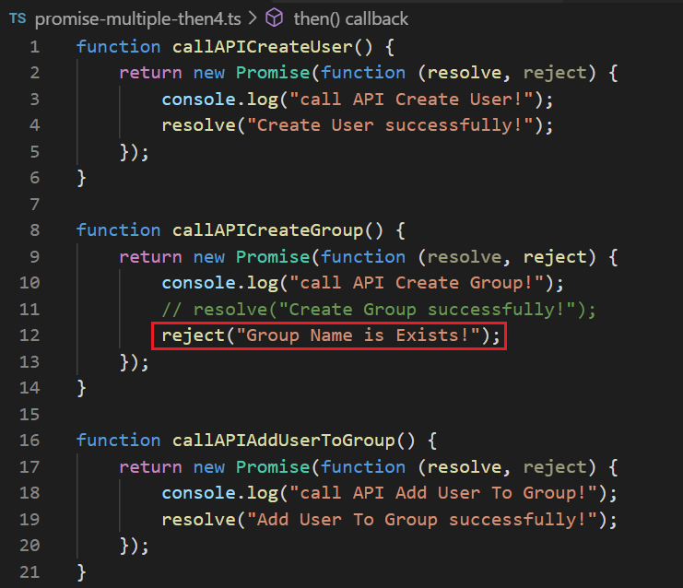
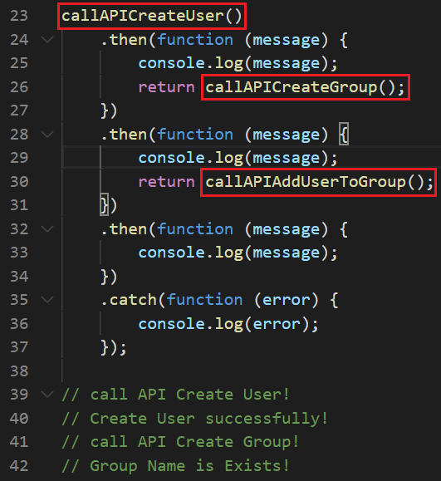
Example

Slide 35
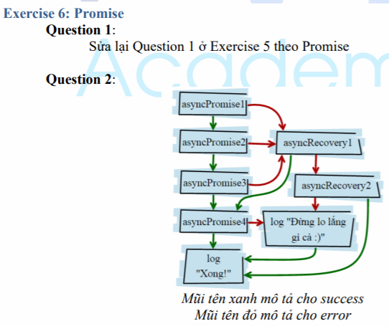
Testing System Assignments
Exercise 6: Promise

Slide 36
Async/Await
ES7
Purpose: Prevent callback method and then() in Promise
Async function
Await

Slide 37
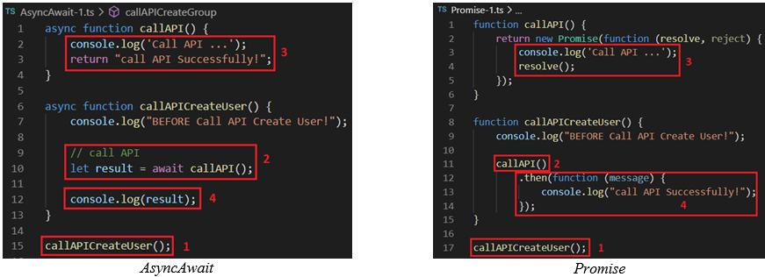
Async/Await
Using await instead of callback method

Slide 38
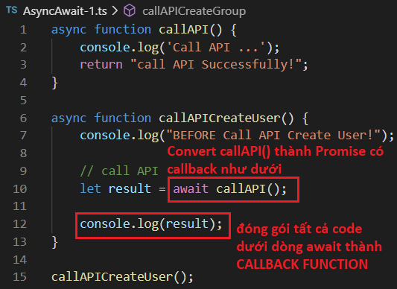
Async/Await
Async function: Declare an asynchronous function(), similar to to 1 Promise
When running await statement, TS will convert into a promise with the callback of the commands after await statement

Slide 39
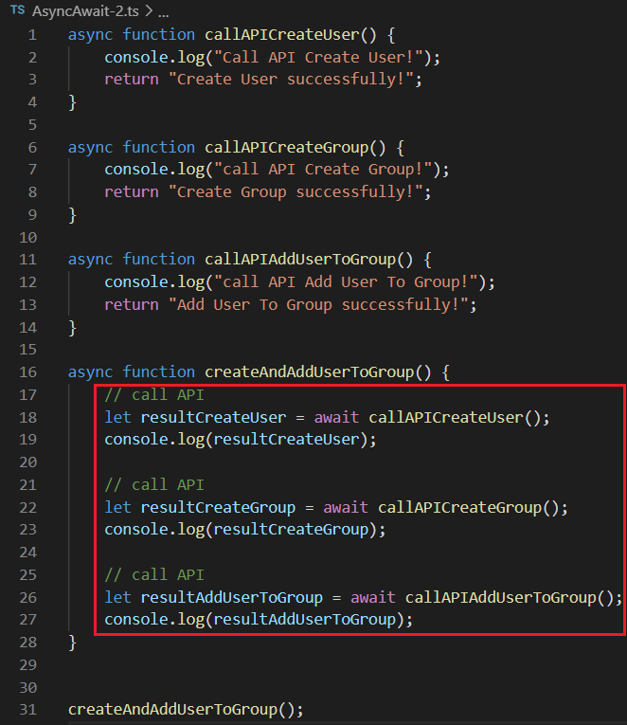
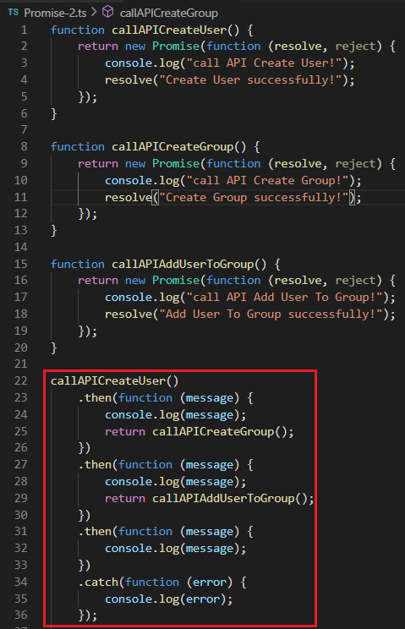
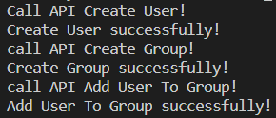
Async/Await
await always in async function
await is a promise which has the following code await is a Callback

Slide 40
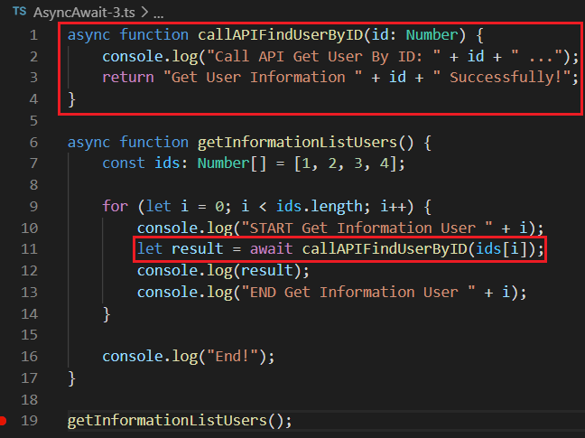
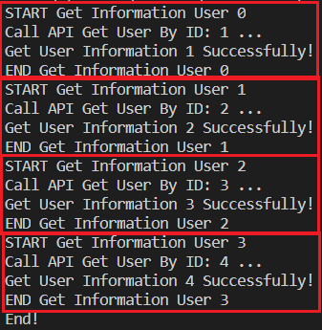
Async/Await
async await & loop
Similar to nested callbacks

Slide 41
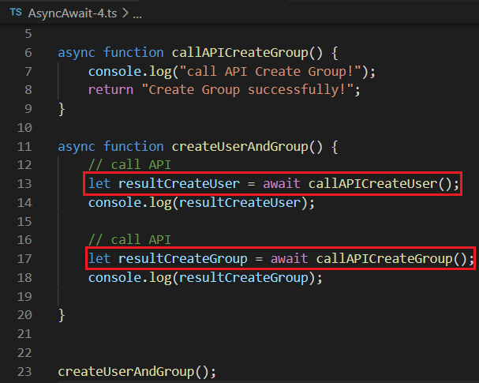
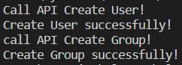
Async/Await
running in order

Slide 42


Async/Await
When calling an async function, if there is not await keyword, the async will return a Promise

Slide 43

Testing System Assignments
Exercise 7: Async Await

Slide 44

Other
Higher-order Function
Reduce Function
Currying Function

Slide 45

Testing System Assignments

Slide 46
Reference
https://www.javatpoint.com/typescript-tutorial
https://www.tutorialspoint.com/typescript/index.htm

Slide 47
Q & A
Copyright © VTI Academy All Rights Reserved

